Slide 1
Brink Preferred Rendering with OpenGL
Mikkel Gjøl
Graphics Programmer
@pixelmager

Slide 2
outline
PC rendering overview
state, shaders, occlusion queries
virtual texturing
bindless vertex attributes
debugging OpenGL
lessons learned
Notes:
Entirely PC specific pipeline, our console setup is a lot different, so this presentation only covers the PC
It’s a AAA game with OpenGL (zomg!1)
Focus on API usage, will not go too much into rendering-algorithm details

Slide 3
splash damage
Founded 2001
Mod team gone pro
Developed Enemy Territory games with id Software
Just finished Brink with Bethesda Softworks
Notes:
UK based games company
Started as a mod-team, Wolfenstein enemy territory -> doom3 multiplayer -> qw:et -> Brink on PC/xbox360/ps3

Slide 6
brink pc-rendering overview
thin, lightweight renderer, data-driven
mostly GL2.x pipeline with GL3.x shaders
Vertex Buffer Objects, Frame Buffer Objects
Vertex- and Fragment-programs
Pixel Buffer Objects for asynchronous VT-readback
Notes:
Thin layer in the sense that we try to move as many responsibilities to the game-code as possible – e.g. Interpolation of post-process values
Not bitsquid-engine level datadriven, but we have a lot of logic in text-files that can be hot-reloaded at runtime.
Adding features at very end of project is viable (e.g. FXAA, though that says more about fxaa... try it today)
No sampler-objects for compatibility reasons.
Target hw nv8800+´/ amd2900+

Slide 7
brink pc-rendering overview
thin, lightweight renderer, data-driven
mostly GL2.x pipeline with GL3.x shaders
Vertex Buffer Objects, Frame Buffer Objects
Vertex- and Fragment-programs
Pixel Buffer Objects for asynchronous VT-readback
single game/render sync-point
r = g;
job-system
physics, collision detection, path finding, VT
Notes:
double-buffered render-data, directly available to the game-code. Single sync-point makes debugging easy.

Slide 8
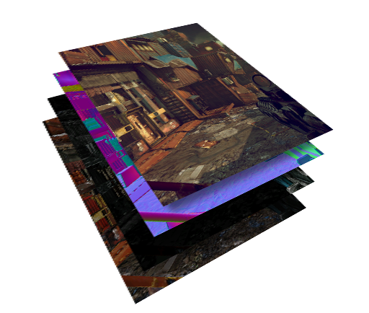
brink pc-rendering overview
fully dynamic lighting, deferred, fat attribute buffers
fast content-iterations on lighting
fast shader-development
fast dynamic lighting
…more work for static lighting
Notes:
Most of this is pretty standard stuff.
One of the reasons for preferring fat gbuffers to “light prepapss” is our virtual texturing pass.
Doing the VT indirection from more than one pass takes long (accessed for normals, and again for albedo/spec etc.)

Slide 9
a frame of brink
Notes:
depth is straight copy from depth-buffer (possible in OpenGL)
Two sets of decals: ”Regular”, emissive or multiplicative decals in transl, albedo-blended in ”decals”
FXAA
HBAO

Slide 10
a frame of brink

Slide 11
a frame of brink

Slide 12
a frame of brink

Slide 13
sorting for state-change
each pass is a list of drawCmds
sorted to reduce statechange
depth:
attribute:
lights:
translucent:
Notes:
A list of objects to be rendered into every renderpass is build and sorted to reduce state-change. No state-”caching” required as only minimal state is set.
A single initial block of state per render-pass (e.g. no depth-test for translucent, no color-write for depth etc.)
In attr-pass, most environment will be static and have the same shaders. Few changes between drawcalls (due to vt)

Slide 14
a drawcall
setGLstate( xor(prevState, drawcmd.stateblock) )
bindRenderProgram( prevRprog )
setUniforms()
setVertexAttribs(xor(prevAttr, drawcmd.vertexAttr))
drawElements()
Notes:
Applies diff-state on drawcall.
Same system applies to vertex-attributes – pointers are changed if they are different
Uniforms are not shared, but could have been using extension.

Slide 15
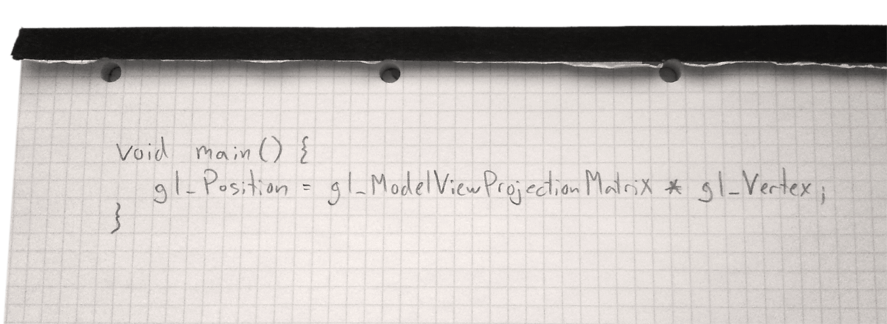
shaders
static set of handwritten shaders available to artists.
written by gfx-programmers and tech-artists together with artists
python-scripts to generate variations with different $defines
~150 files, ~350 shader-combinations, ~3sec compile-time
Notes:
Artists will usually team up with a gfx-programmer or tech-artist to create new shaders.
We have been very happy with this model. The artists too. Few shaders: Less places to optimize – and optimizations done affect more areas.
Low number of shaders largely due to deferred rendering
Low compile-time means not necessary to cache binary shaders (using extension)

Slide 16
shader pre-processor
renderProgram basic_skinned
vertex glsl {
$define use_skinning
$include "include/vertex_glsl.inc“
}
fragment glsl {
$define use_phong
$include "attribute/attr_frag_glsl.inc"
}
Notes:
We built a shader-preprocessor to allow us to write less, and more efficient shader-code.
Output from python script: adds a number of defines that changes the behaviour of the includede files.

Slide 17
shader pre-processor
Regular preprocessor functionality (some now natively in glsl)
$include "inc/preferred_glsl.inc"
$define PREFERRED_RENDERING
$ifdef PREFERRED_RENDERING
return bestValue();
$else
return fuglyHack();
$endif
// vertex-attributes looked up by name
vec4 vertexColor = $colorAttrib;
//uniforms / textures mapped on shader-load
vertexColor = vertexColor * $colorModulate + $colorAdd;
vec4 diffuse = texture( $diffMap, texCoord ) * vertexColor;
Notes:
Pre-processor does the usual stuff – a lot of it now available, but was not at the time of writing

Slide 18
shader pre-processor
Regular preprocessor functionality (some now natively in glsl)
$include "inc/preferred_glsl.inc"
$define PREFERRED_RENDERING
$ifdef PREFERRED_RENDERING
return bestValue();
$else
return fuglyHack();
$endif
// vertex-attributes looked up by name
vec4 vertexColor = $colorAttrib;
//uniforms / textures mapped on shader-load
vertexColor = vertexColor * $colorModulate + $colorAdd;
vec4 diffuse = texture( $diffMap, texCoord ) * vertexColor;
Notes:
Pre-procssor also picks up uniforms, textures and vertex-attributes (essentially just defines again), making it easy to add new uniforms that are then picked up from code.
(added bonus: It’s easy to spot uniforms in code)

Slide 19
occlusion queries
area and frustum-culled before OCQ
Notes:
Game does area, portal and frustum-culling before any occlusion queries

Slide 20
occlusion queries
area and frustum-culled before OCQ
render world-space bboxes / light-frustum
if predicted visible, issue OCQ during rendering
~60 avg, ~200 max OCQ per frame ~0.5ms
Notes:
Dicing of static geometry based on geometry-density – roughly 8x8x8m chunks
If lights are visible, we wrap the actual render-call in an OCQ (could do the same for geometry, but we don’t....)

Slide 21
occlusion queries
initial version stalled on frame n+1
proved to be a bottleneck

Slide 22
occlusion queries
if not ready, assume nothing changed
do not issue new OCQ
expand bbox in view-movement-direction to predict visibility
Notes:
Bbox expansion per box, along world-major axis is fine – could do better but no gain as coarse approx anyway

Slide 23
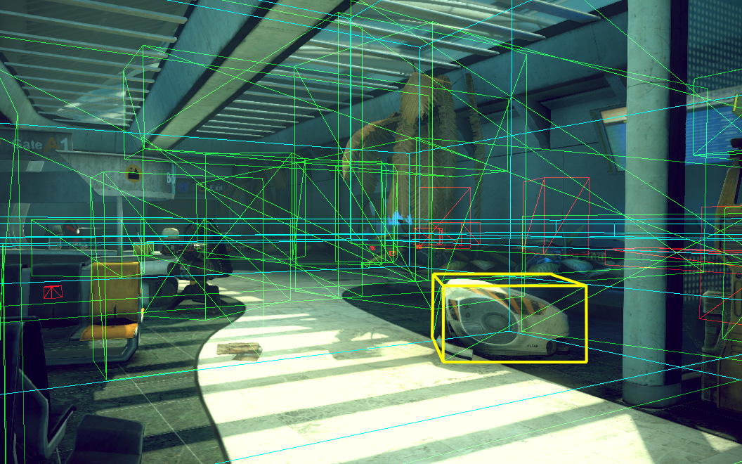

Slide 24
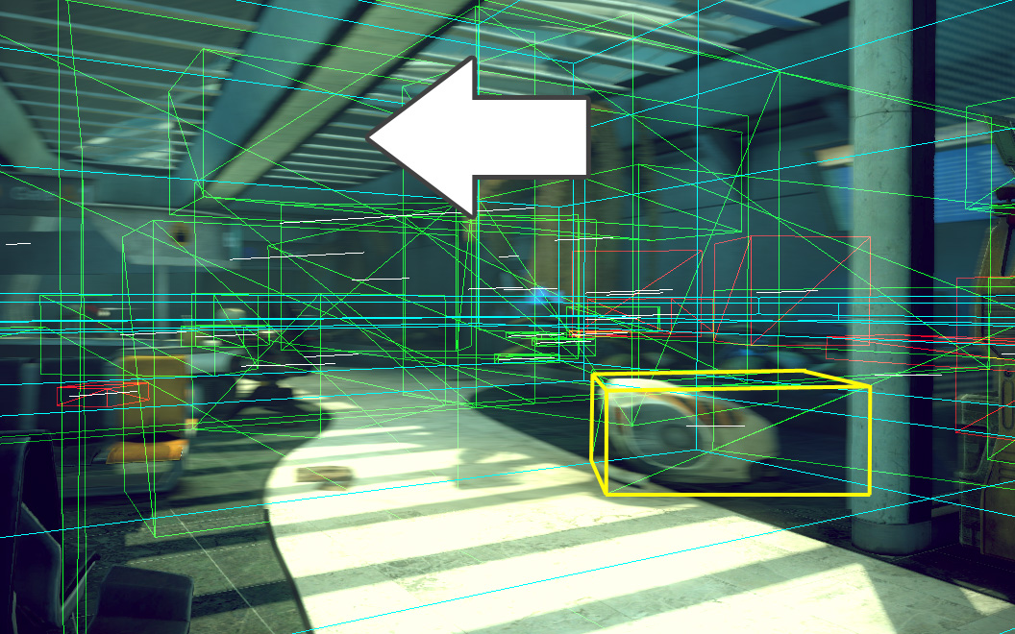

Slide 25
virtual texturing
Notes:
Multiple sources

Slide 26
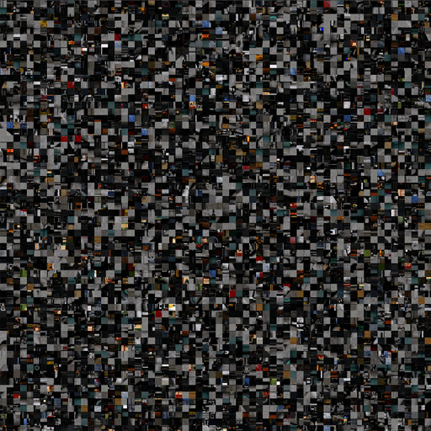
virtual texturing
only load the texels you need
same texel-density everywhere on screen
Notes:
Essential idea is to only load the data needed – same goal as any other streaming system.

Slide 27
virtual texturing
only load the texels you need
same texel-density everywhere on screen
reduces complexity for artists
”texture however you want, as long as it fits”
Notes:
One of the main benefits is the reduced complexity for artists: They can use as much texture as they want, as long as it fits on disk.
(they still need to worry about varying texel-density, as we don’t have a step that unifies this.... It is possible though).
A build-step takes all textures and packs them into an atlas, then modifies the vertex-data uv-coordinates to point to the new UV.
(it also saves original texture-size to allow for texture-wrapping).
Brink is not limited to entirely unique textures, we allow for reuse of textures, and texture-wrapping.
Unique is slightly faster in shader, but requires more memory... Allowing re-use is why we can ship on one dvd, and not three....

Slide 28
virtual texturing
only load the texels you need
same texel-density everywhere on screen
reduces complexity for artists
”texture however you want, as long as it fits”
reduces dependency between drawcalls
everything uses the same texture
...actually we have multiple pagefiles
Notes:
As all objects are using the same texture (the virtual one), there is a significantly reduces dependency between drawcalls.
this allows us to 1. dice up the world across objects, and 2. never change textures while rendering vt objects
We have multiple page files which leads to multiple address spaces. E.g. dynamic objects are in a separate address-space. Each level has a separate file. Support 256 concurrent address-spaces – DLC accesses 3.

Slide 29
virtual texturing
Notes:
Quickly showing Virtual Memory, as virtual texturing is essentially the exact same thing....
Translation-lookaside-buffer holds translation values from vt-addr -> phys addr.

Slide 30
virtual texturing
Notes:
Rendering uses the page table in the shader to convert from virtual to physical coordinates to look up the correct texture mapping 3 dependant texture-reads into virtual textures (diffuse / normal / specular). All using the same UV – so essentially a single TLB with multiple address-spaces.
Never fails completely – always loads lowest 3-4 mip levels on level-load (only a couple hundred kb)

Slide 31
virtual texturing
Notes:
low-res packed rgba32 ID-buffer
- page_u, page_v, mip-level, <virtual adress-space index>
ID buffer gets rendered and read back Analysis determines a page miss (in case of page-hit, MRU table gets updated) Page gets reserved in the physical address space (8192x8192, storage is DXT textures, 4096x4096 on consoles) Page data gets loaded from storage, then transcoded from DCT to DXT “TLB” (2D texture with 1 texel/page in the address space) gets updated with mapping information from virtual to physical coordinates

Slide 32
virtual texturing
processing mapped memory from separate thread
PBO mapped pointer valid in all threads
Notes:
The PBO being valid in all threads makes it easy to utilize other threads for the analysis

Slide 33
virtual texturing
processing mapped memory from separate thread
PBO mapped pointer valid in all threads
minimum 1 frame delay for async readback
2+ frames delayed for multi-GPU
Notes:
With alternate-frame-rendering using SLI, you need to add a frame latency for an async texture readback per GPU in order to not stall a gpu during rendering

Slide 34
virtual texturing
processing mapped memory from separate thread
PBO mapped pointer valid in all threads
minimum 1 frame delay for async readback
2+ frames delayed for multi-GPU
anisotropic mip-selection, bi-linear filtering
Notes:
Using the hw anisotropic mipmap-selection, but does plain bi-linear filtering

Slide 35
bindless vertex attributes
decouples vertex-format from vertex-pointers
provides direct GPU-pointer, reducing indirection-overhead in driver
GL_NV_vertex_buffer_unified_memory GL_NV_shader_buffer_load
Notes:
This extension is all about helping the driver out, reducing the amount of work it is required to do
Lower-level api than usually available.

Slide 36
bindless vertex attributes
glVertexAttribPointerARB( ATTR_COL, 4, GL_UNSIGNED_BYTE,
GL_TRUE, vertsiz, ofs_col );
glBufferAddressRangeNV( GL_VERTEX_ATTRIB_ARRAY_ADDRESS_NV,
ATTR_COL, vbo_gpu_addr+ofs_col,
vbo_gpu_siz-ofs_col );
glVertexAttribFormatNV( ATTR_COL, 4, GL_UNSIGNED_BYTE,
GL_TRUE, vertsiz );
Notes:
On top the usual GL-setup
On bottom using the bindless extensions.
The format is split out to a separate call. Looking at Brink, this is significant as most of our vertex-data is of the same format.
This means that we never change vertex-formats during our main render-passes.

Slide 37
bindless vertex attributes
implementation revealed the slack in our attribute-code, drivers are forgiving
this was the main work - writing the code was easy…
use debug-context to spare crashes (thanks Jeff Bolz!)
Notes:
The bulk of the work was to fix the places in our code where we relied on magic in the drivers. We were being slack without knowing it.
Dealing with direct gpu pointers means you will hang your gpu every time you do something wrong – and doing the initial conversion, that is every time.
Thanks to some quick work from the nvidia-guys, the debug-context will now not only not-hang, it will tell you what call would have hung, and what you were doing wrong. Greatly eases the implementation.

Slide 38
bindless vertex attributes
implementation revealed the slack in our attribute-code, drivers are forgiving
this was the main work - writing the code was easy…
use debug-context to spare crashes (thanks Jeff Bolz!)
practically got rid of vertex-attribute cpu-overhead
5-10% of CPU frame-time
…not practical for frame-temporary allocations Getting GPU-address takes time.
Notes:
Result of this was a nice reduction in the CPU time taken up by setting vertex-attribs. This was around 5-10% of our render cpu-time.
Brink does ”naïve” frame-temporary memory allocations, effectively allocating new VBOs for every object that requires memory (typically gui or particles).
This works very well (we used to have a more elaborate setup, allocating a single chunk of memory, but the driver actually handles these allocations very well - may as well use that).
Ironically, when then optimizing vertex-attr. code, the frame-temp alloc. gets in the way.

Slide 39
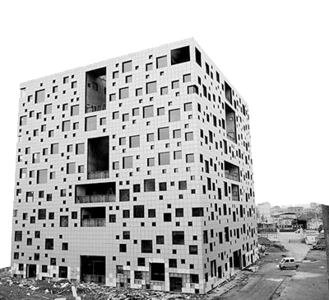
creating a window
x2 contexts
one to get wgl-extensions to create the "real" one
the real one….
Notes:
Haven’t seen it documented anywhere, so added here.
Creating a window requires two contexts.

Slide 40
creating a window
x2 contexts
one to get wgl-extensions to create the "real" one
the real one….
x2 windows
one to eat the Windows "maximize"-window call at launch
one to render the game
Notes:
..and two windows, as Windows’ shortcuts can overwrite the parameters of the first CreateContext-call.
The window needs to be visible, but can be destroyed immediately.

Slide 41
creating a window
use wglShareLists to share data between contexts
or just share via wglCreateContextAttribs
useful between editor-windows / game, windowed/fullscreen

Slide 42
debugging OpenGL - tools
gDebugger / glIntercept for cmdBuffer debugging
useful for checking correct textures/shaders/"meshes“
Notes:
Debugging really is the #1 time-sink during development.
gDebugger / gl-intercept (which hopefully will continue to work on nv-hw) is very useful to make sure you are actually doing what you think you are doing – allows you to inspect command-buffer.
Wish: glIntercept with webgl preview? ...with gpad geometry-preview? ...and shaders? ...hotreloadable..? One can only dream...

Slide 43
debugging OpenGL - tools
gDebugger / glIntercept for cmdBuffer debugging
useful for checking correct textures/shaders/"meshes“
Nsight / GPU PerfStudio almost useful for timing.
NSight has actual start/end drawcall GPU-times! Only way to get this. Try it today!
Neither is very mature for OpenGL
Notes:
Nsight / GPU perfstudio are mostly useful for timing-purposes, but they require some more work to be truely useful for OpenGL AAA games.
(Nvidia released app profiler lib apprears to be able to do this level of profiling on it’s own).
We tried App Analyzer, which looks very promising, but it didn’t produce . We are hopeful though.
(intel-tool is not targeted at working for opengl at all)

Slide 44
debugging OpenGL - tools
gDebugger / glIntercept for cmdBuffer debugging
useful for checking correct textures/shaders/"meshes“
Nsight / GPU PerfStudio almost useful for timing.
NSight has actual start/end drawcall GPU-times! Only way to get this. Try it today!
Neither is very mature for OpenGL
no tools currently shows FBO or geometry
Notes:
None of the tools show content of FBOs. GPU perfstudio looks very promising for OpenGL though. App Analyzer is meant to show FBOs.

Slide 45
debugging OpenGL – custom code
hot-reloadable assets
shaders / textures / meshes / assets
runtime-modifying shaders for debugging
Notes:
Roll your own. Everyone wants 360pix + gpad to have a magical lovechild that does everything.
If you can hot-reload at runtime, and quickly iterate on code, that’s a very viable alternative.
Hot-reloadable assets – main solution, very useful! Option to override packaged assets runtime.
shaders / textures / meshes / assets... this is the most important debugging-tool!
Typical debugging session is quickly modifying shaders to extract the necessary debug-data.

Slide 46
debugging OpenGL – custom code
hot-reloadable assets
shaders / textures / meshes / assets
runtime-modifying shaders for debugging
“configurable” render-stages
various visualization modes
wire, batches, info on obj, lights, ocq etc.
show textures / rendertargets, write to files
Notes:
Also adds a number of debug render-modes to allow a level of debugging for non-coders. Very useful for artists to see e.g. tangent-spaces, overdraw etc.

Slide 47
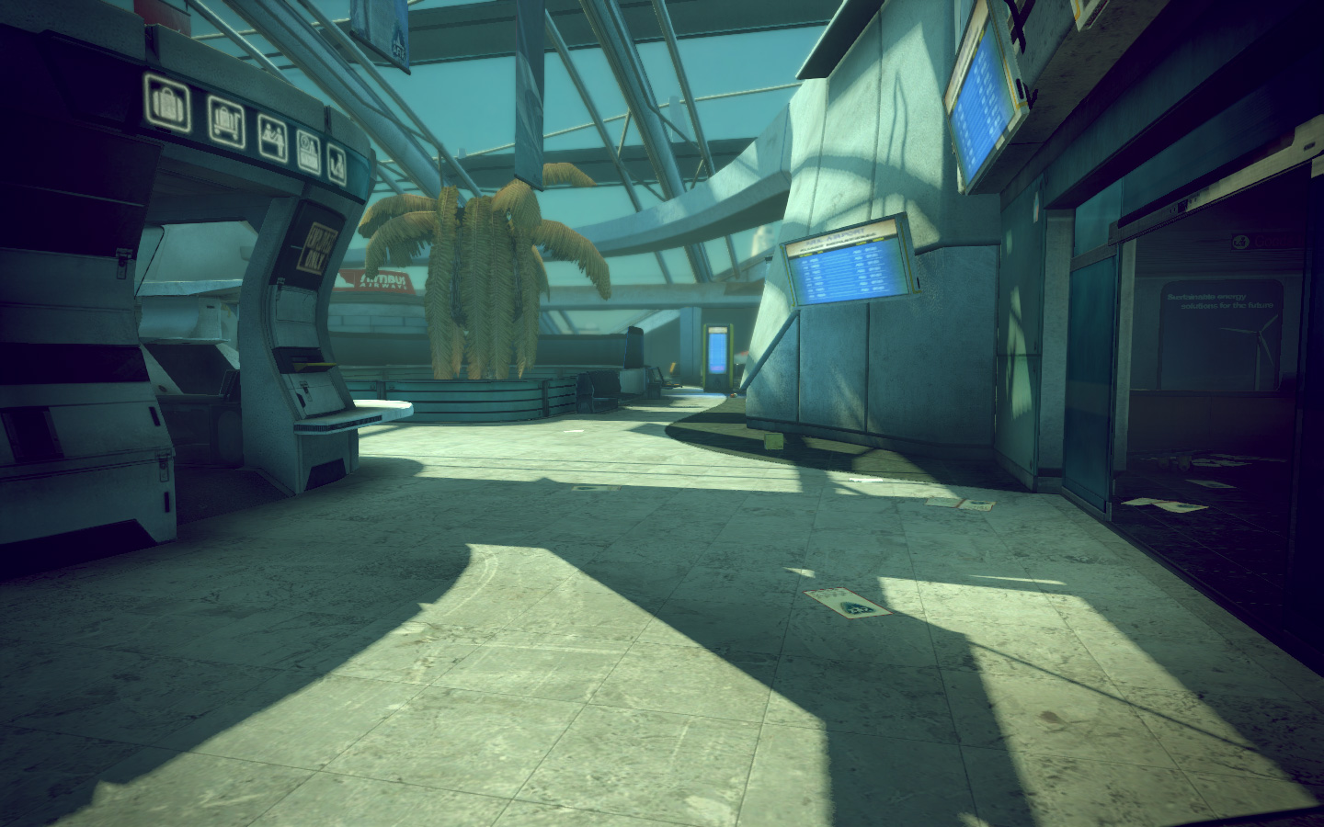

Slide 48
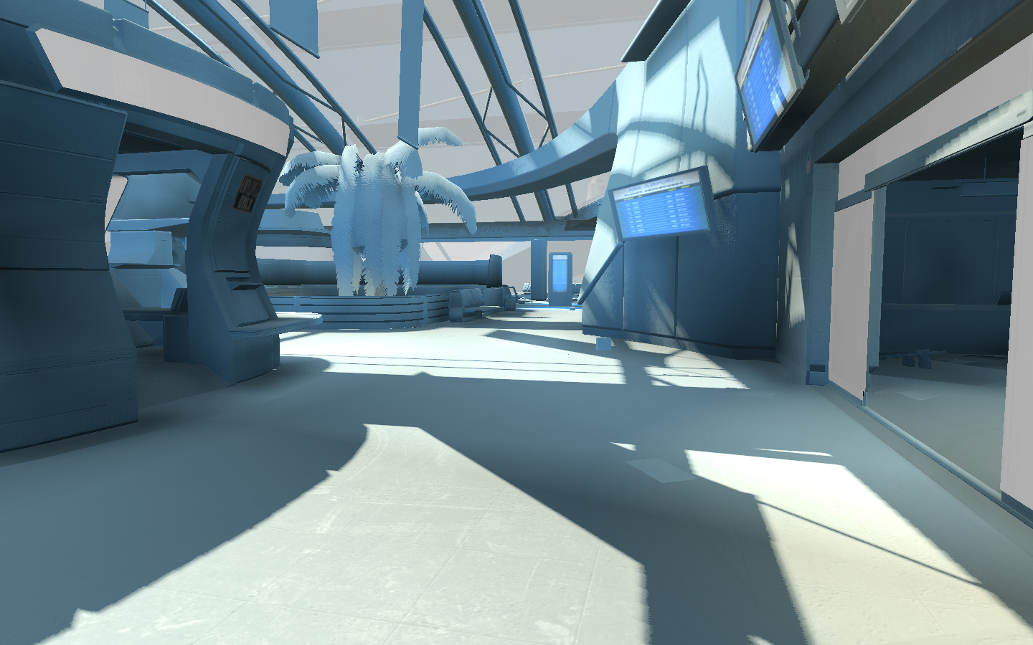
Notes:
Selectively disabling different types of texturing: diffuse / specular / bump etc.

Slide 49
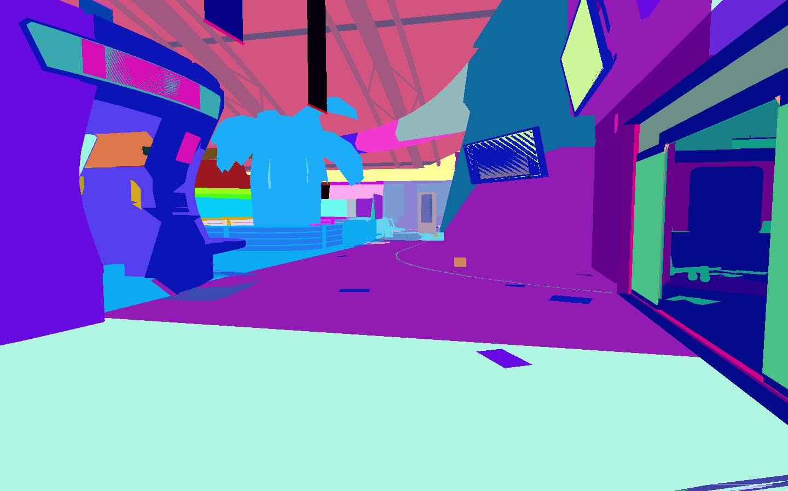
Notes:
Dicing across objects, based on geometry density – builds BSP-tree

Slide 50
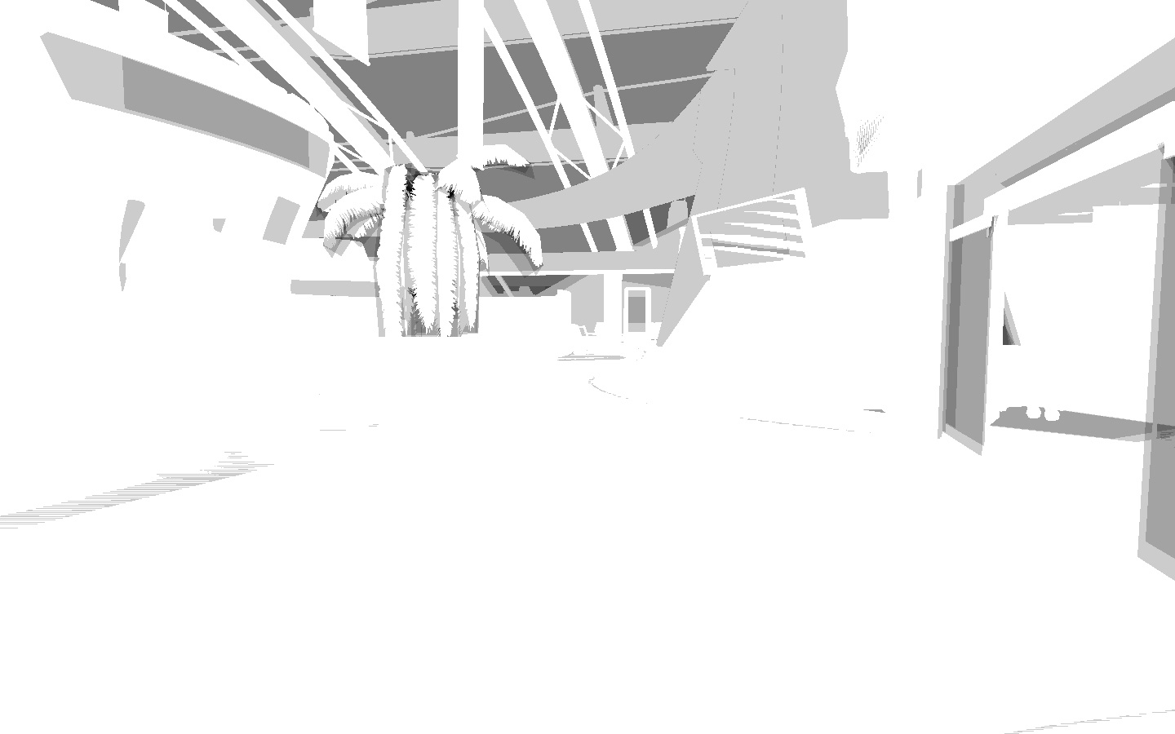
Notes:
Overdraw – mostly for particles (valid to see alpha-tested overdraw as well)

Slide 51
debugging OpenGL – custom code
full OpenGL-statedump
write to file and diff
queryTimers for profiling
Make sure to pair with CPU-timings to find all bottlenecks
Notes:
Break when something is bad, dump state, return to normal, dump state – diff in favourite tool
The Printf of gfx-debugging.
static bool dumpstate = false;
if(dumpstate) { dumpstate = false; glStateToFile(); }

Slide 52
lessons learned
do not trust state: Reset per frame
Notes:
You’re not the only one rendering. Steam and friends that render overlays, grabbing your context.
paranoid-mode sanity checks of hw-state, making sure it is what we think it is before a dra

Slide 53
lessons learned
do not trust state: Reset per frame
use the debug context. Add it today! ~1 hour
Notes:
Cort Stratton / naughty dog altdevblogaday post on debug-context
Using the debug-context removes the tedious glerror bisection of code, trying to find the villain-functioncall

Slide 54
lessons learned
do not trust state: Reset per frame
use the debug context. Add it today! ~1 hour
no vendor-independent solutions exists for dual-GPU laptops
Notes:
For laptops with two GPUs, a low-power one and a high-power one, there is no ”standard” for how to pick the right GPU to run on.
There are vendor-dependant ways to do this (e.g. Nvapi), but a unified solution should be developed.

Slide 55
lessons learned
do not trust state: Reset per frame
use the debug context. Add it today! ~1 hour
no vendor-independent solutions exists for dual-GPU laptops
keep a small code-setup for tests
driver teams appreciate small reproduction-programs with source-code too
Notes:
Small isolated code-setups are very handy to figure out api-quirks.
Driver-teams respond very well when sent small code-setups that show errors and reproduce claimed driver-bugs (that mostly are not).
...a lot better than ”my game doesn’t work, here’s a nightly snapshot, you need to run over to the dragon on level 4 and stab it with the banana.... the particle-effect should be red!! Fixit!”

Slide 56
conclusions
OpenGL works for AAA games
OpenGL-support was never an issue
d3d10 on Windows XP
Notes:
OpenGL allowed for direct3d 10 level functionality on all the platforms our customers were using.

Slide 57
conclusions
OpenGL works for AAA games
OpenGL-support was never an issue
d3d10 on Windows XP
responsive IHVs
AAA can “force” updated drivers
Notes:
Hardcore shooters have it easy. Our customers are mostly invested enough in the game that they will update their drivers to get the game to run (they are also used to having to do this).
IHVs are very responsive and the great relationship with them means any kinks will be ironed out before shipping.

Slide 58
OpenGL wishlist
IHV to use the debug-context more
enable a lower-level api
GL_PARANOID_LEVEL = INT_MAX;
performance warnings
Notes:
The dbg-context is great, and should be used more – e.g. for performance warnings.
The debug-context allows for a lower level of api.
Rather than have the driver-teams write tons of fixup-code, show us what we are doing wrong so we can fix it.
Add a “paranoid-mode” that will “treat warnings as errors”

Slide 59
OpenGL wishlist
more stateless / bindless / named -style API
less errorprone, more readable
faster
asynchronous resources to empower threads ("mapBuffer"-style works fine)
Notes:
We really appreciate the direction the API is going with bindless/named/stateless functions. More of that please.
Updating memory via mapped pointers allows us to easily use multiple threads – more of this would be handy (e.g. updating uniforms from sep. threads?)

Slide 60
OpenGL wishlist
light-weight Display Lists
this is our current console setup!
ideally, we would still like to be able to set state... sorry.
GPU self-feed would be great!
Notes:
There is a very large overlap of work between frames. On consoles we are able to take advantage of this, build commandbuffers and simply patch these up with changed data (typically matrices) per frame. Being able to do this on PC would be great. We really want something like Display Lists, but restricted to make them meaningful for hw.
GPU selffeed for gpu-based occlusion etc. would be great. The best exact form is not entirely clear.

Slide 61
references
http://brinkthegame.com/
http://origin-developer.nvidia.com/object/bindless_graphics.html
http://altdevblogaday.com/2011/06/23/improving-opengl-error-messages/
http://glintercept.nutty.org/
http://developer.amd.com/tools/gDEBugger/Pages/default.aspx
http://parallelnsight.nvidia.com/

Slide 62
acknowledgements
Arnout van Meer / Splash Damage
Romain Toutain / Splash Damage
Simon Green, Phil Scott, Jeff Bolz of NVIDIA fame
Nicolas Thibieroz, Kevin Strange of AMD fame
All images are copyright of their respective owners

Slide 63
Teh Jobs
We’re hiring: www.splashdamage.com/jobs
@splashdamage
Splash Damage

Slide 64
Teh Questions?
Ask us anything!
Notes:
mig@splashdamage.com

